Slide 1
Introductory General Chemistry
Chemistry 3A
Experiment 12b
Determination of Citric Acid in Soda
Mitch Halloran

Slide 2
Introduction
Titrations are used to determine quantitatively amounts (as concentrations) of a substance in solution
This experiment will use sodium hydroxide (NaOH) as a titrant to determine amount/concentration of citric acid in a lemon-lime soft drink

Slide 3
Procedure
The titrant is placed in a buret and the analyte to be titrated will be placed in an Erlenmeyer flask
Small volumes (aliquots)

Slide 4
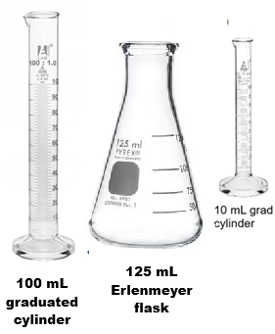
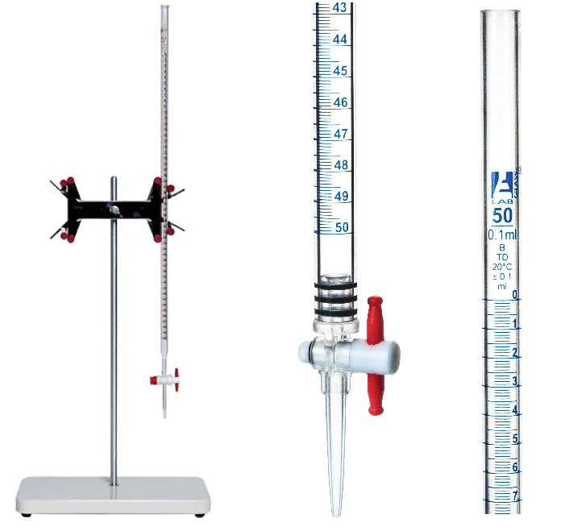
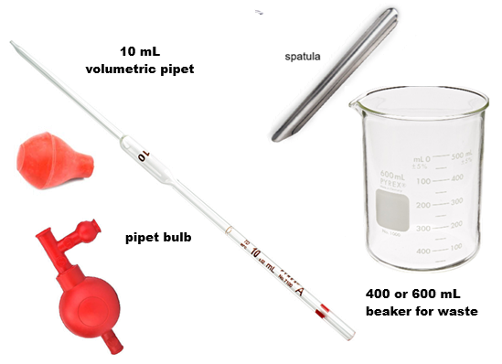
Equipment You Will Use

Slide 5
Consumables You Will Use

Slide 6
Procedure
This experiment has two parts
In part 1, you will do at least 3 trials of standardizing the concentration of a NaOH solution using oxalic acid dihydrate. This involves getting a mass of oxalic acid on the balance, dissolving it, and neutralizing it with a color pH indicator to its endpoint
In part 2, you will use the NaOH solution to neutralize another acid, citric acid, determining the volume you used, to determine the concentration of the acid in a soft drink. This too will be done in 3 trials
In each trial of all parts, it is necessary to achieve the proper color of the indicator to be accurate

Slide 7
Procedure
Preparing the buret
Rinse the buret with 5 mL DI water three times (turn buret on side and rotate it). Collect the rinse in a large waste beaker.
Repeat rinsing but with 5 mL of the titrant NaOH solution
Clamp the buret to the stand and with the waste beaker under it and stopcock open, add several mL to buret. As it flows, close stopcock. Ensure flow has filled buret tip

Slide 8
Procedure
Part I-Standardization
Fill buret with ~0.1 M NaOH titrant between the 0 and 3 mL mark
Record initial buret reading to correct precision: if the smallest division mark is 0.1 mL, then the precision should be ±0.01 mL
Oxalic acid
Put glassine weigh paper on balance and tare (zero)
Spoon out between 0.1000 and 0.1200 g oxalic acid dihydrate and record mass
Transfer the acid completely without spilling into flask
Add about 10 mL DI-water in 10 mL graduated cylinder to the flask with acid, swirl to dissolve
Add 2-3 drops phenolphthalein to flask

Slide 9
Procedure
Part I-Standardization
Place piece of white paper under flask to observe any color change
Swirl flask and quickly add 10 mL NaOH from buret
Drop-by-drop titration
The stopcock will be turned only to permit drop by drop addition of NaOH. Turn the stopcock on and off in controlled manner to dispense drops as necessary. As flask is swirled with each drop, look for pink color to appear. With each drop, the color may disappear more slowly. As the endpoint is reached, a very faint pink color will persist in solution.
The best control is to quickly rotate stopcock by 180°, or to form a tiny drop in the tip, and touch tip to inside of flask wall

Slide 10
Procedure
Part I-Standardization
Record the final buret reading
Repeat the standardization steps for additional trials, and especially if over-titrations occurred (the pink is too intense/bright)

Slide 11
Procedure
Part II-Determination
Get about 40 mL of soft drink in small beaker. Note it will have lost its carbonation.
Use a 10 mL volumetric pipet to transfer precisely 10.00 mL to clean, well-rinsed Erlenmeyer flask.
Add 2-3 gtt phenolphthalein indicator to flask
Fill the buret to between 0-3 mL marks with the ~0.1 M NaOH solution.
Titrate the soda as for the standardization procedure
Record final volume
Repeat the number of trials.

Slide 12
Example Data Analysis
Part I-Standardization
Calculate the moles of NaOH reacting with the known mass of oxalic acid. Note that 2 mol NaOH reacts with 1 mol oxalic acid
Convert the NaOH titrant volume from mL to L
Calculate the concentration (molarity) of NaOH from the standardization
Part II-Determination
Calculate the liters NaOH (from mL) titrant used for the citric acid
Calculate the mole citric acid using mean NaOH concentration and volume NaOH. 3 mol NaOH reacts with 1 mol citric acid

Slide 13
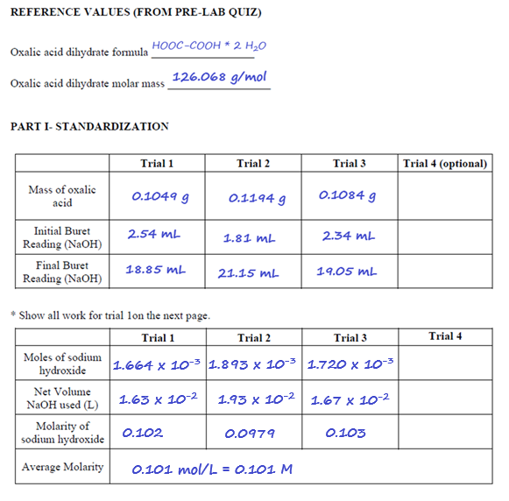
Example Data Analysis

Slide 14
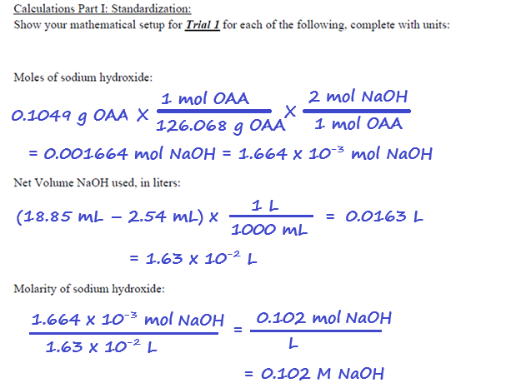
Example Data Analysis

Slide 15
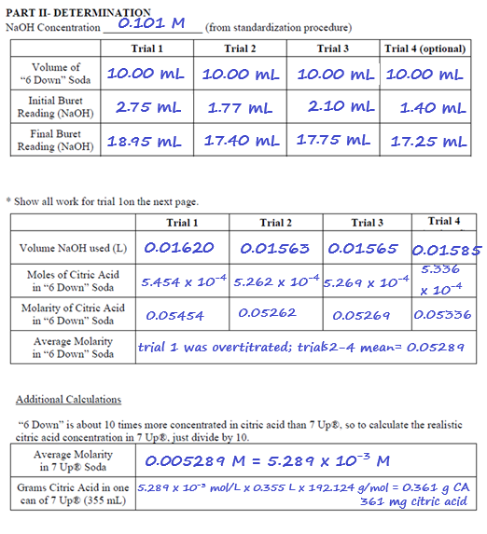
Example Data Analysis

Slide 16
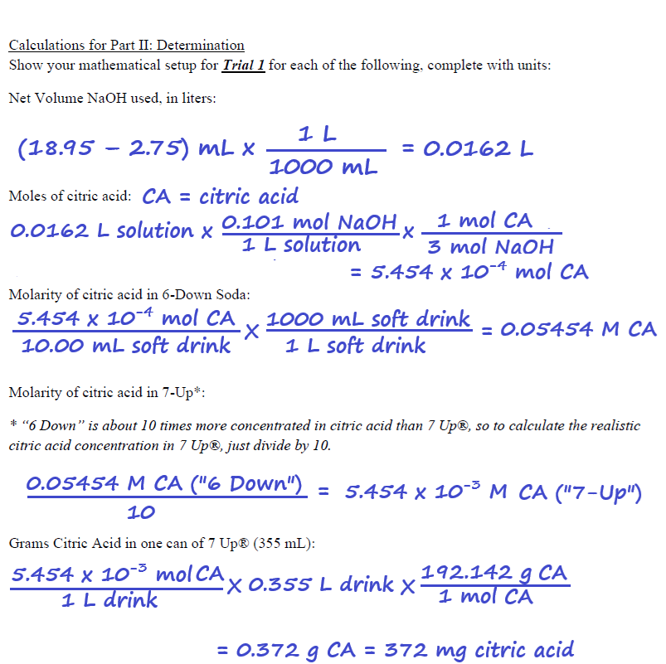
Example Data Analysis

Slide 17
Clean Up
Pour waste solutions in the aqueous solution carboy located in the fume hood (usually placed near door)
Clean up other equipment as done previously in the lab

